Slide 1
Arthritis
& forms of Inflammatory Arthritis
Oluwaleke Ganıyu SOKUNBI (Ph.D.)
Professor or thorthopaedics, Sports and Manual therapy

Slide 2
Presentation outline
General Information
Epidemiology
Specific features of the different forms of Arthritis
Diagnosis
Intervention
Role of physiotherapy management

Slide 3
General Information

Slide 4
General Information
Evidence of osteoarthritis and potentially inflammatory arthritis was first discovered in dinosaurs
It was noted in skeletal remains of Native Americans found in Tennessee (5000 to 500 BC)
Scientists are not sure how long humans have been experiencing it
https://en.wikipedia.org/wiki/Arthritis

Slide 5
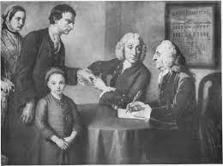
General Information
1715
One of the most important publications on arthritis was by Dr. William Musgrave called the De Arthritide Symptomatica’.
It is the earliest known text describing in detail the symptoms of RA.
https://en.wikipedia.org/wiki/Arthritis

Slide 6
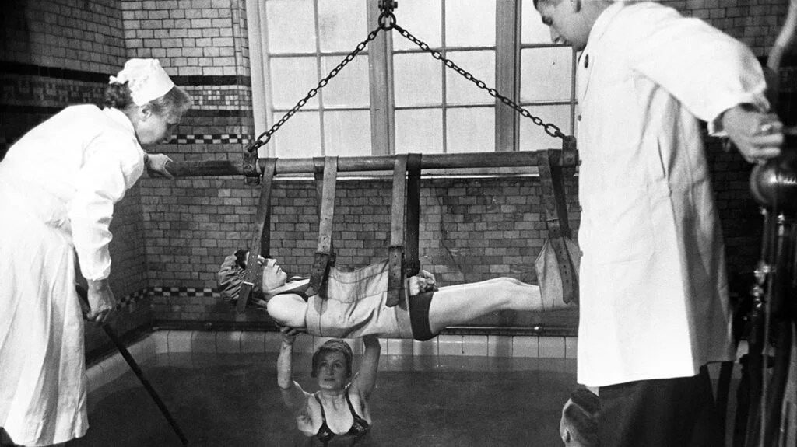
General Information
1772-1840
Frencjh Scientist , Augustin Jacob Landré-Beauvais, first wrote about his treatment in 1800
https://en.wikipedia.org/wiki/Arthritis

Slide 7
DIFFERENT FORMS OF
INFLAMMATORY ATHRITIS
There are over 100 types of arthritis.
The most common forms
Osteoarthritis (OA)
Rheumatoid arthritis (RA)
https://en.wikipedia.org/wiki/Arthritis

Slide 8
DIFFERENT FORMS OF ATHRITIS
Osteoarthritis
Rheumatoid Arthritis
Septic Arthritis
Ankylosing spondylitis
Gout & Pseudo gout
Juvenile Idiopathic Arthritis
Septic Arthritis
Psoriatic Arthritis
etc.

Slide 9
DIFFERENT FORMS OF
INFLAMMATORY ATHRITIS
Arthritis" literally means joint inflammation = Inflammation of the joints
There are deferent forms of arthritis with different causes and different tissues and organs could be affected
https://en.wikipedia.org/wiki/Arthritis

Slide 10
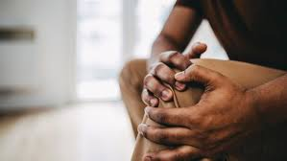
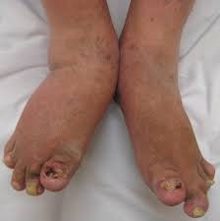
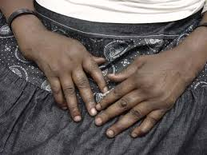
DIFFERENT FORMS OF ATHRITIS
The different form of arthritis mıght vary in pattern, severity, and location of symptoms.
They all have effects on functional mobility, activity limitation, participation restrıctıons & Quality of life

Slide 11
EPIDEMIOLOGY

Slide 12
Epidemiology (OA)
WHO
In 2019, about 528 million people worldwide were living with osteoarthritis; an increase of 113% since 1990 (1)
About 73% of people living with osteoarthritis are older than 55 years (1)
With ageing populations and increasing rates of obesity and injury, the prevalence of osteoarthritis is expected to continue to increase globally (1)
60% are female.
The knee is the most frequently affected joint, followed by the hip and the hand (2) .
GBD 2019: Global burden of 369 diseases and injuries in 204 countries and territories, 1990–2019: a systematic analysis for the Global Burden of Disease Study 2019. https://vizhub.healthdata.org/gbd-results/.
2. Long H, Liu Q, Yin H, Diao N, Zhang Y, Lin J et al. Prevalence trends of site-specific osteoarthritis from 1990 to 2019: Findings from the global burden of disease study 2019. Arthritis Rheumatol 2022; 74(7): 1172-1183.

Slide 13
Epidemiology (OA)
WHO
344 million people living with osteoarthritis experience severity levels (moderate or severe) that could benefit from rehabilitation
Cieza A, Causey K, Kamenow K, Wulf Hansen S, Chatterji S, Vos T. Global estimates of the need for rehabilitation based on the Global Burden of Disease study 2019: a systematic analysis for the Global Burden of Disease Study 2019. Lancet. 2020 Dec 19; 396(10267): 2006–2017.

Slide 14
Epidemiology (RA)
WHO
In 2019, 18 million people worldwide were living with rheumatoid arthritis (1)
About 70% of people living with rheumatoid arthritis are women,
55% are older than 55 years (1).
13 million people with rheumatoid arthritis experience severity levels (moderate or severe) that could benefit from rehabilitation (2)
GBD 2019: Global burden of 369 diseases and injuries in 204 countries and territories, 1990–2019: a systematic analysis for the Global Burden of Disease Study 2019. https://vizhub.healthdata.org/gbd-results/.
2. Long H, Liu Q, Yin H, Diao N, Zhang Y, Lin J et al. Prevalence trends of site-specific osteoarthritis from 1990 to 2019: Findings from the global burden of disease study 2019. Arthritis Rheumatol 2022; 74(7): 1172-1183.

Slide 15
http://www.cdc.gov/arthritis/data_statistics/disabilities-limitations.htm
Epidemiology
2022
9.8% (22.7 million people) of U.S. population now report to be activity limited due to arthritis
37% of those with arthritis in 2030 will report having their activity limited due to the disease

Slide 16
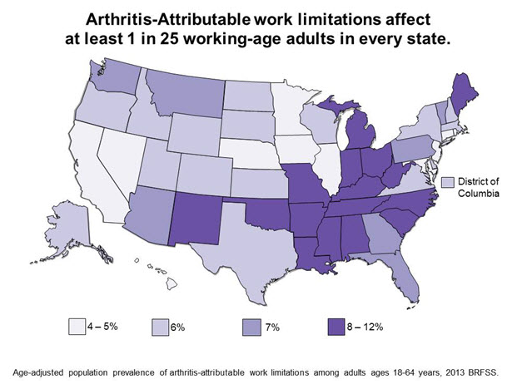
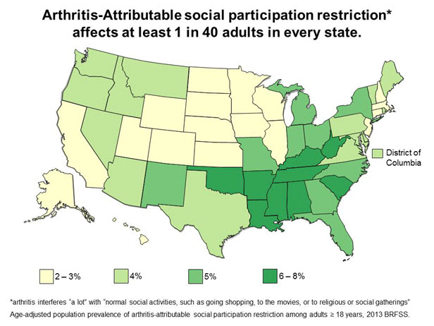
http://www.cdc.gov/arthritis/data_statistics/disabilities-limitations.htm
Work Limitations due to Arthritis, Adults 18-64, BRFSS 2013
Social Participation Restriction, BRFSS 2013

Slide 17
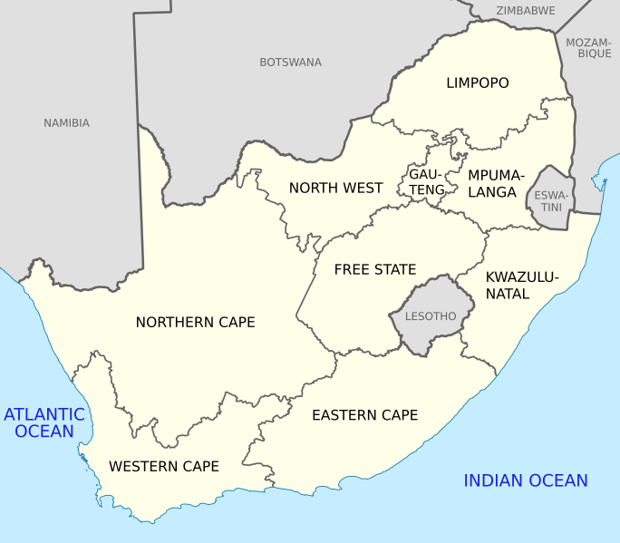
Epidemiology
A systematic review by Osenbo et al., 2015 on the prevalence of six types of arthritis in Africa; namely rheumatoid arthritis, osteoarthritis, juvenile arthritis, psoriatic arthritis, gout, and ankylosing spondylitis. (44.4% of the studies were from SA)
South Africa (SA)
82.7% among adults aged over 65 years
highest prevalence of 33.1% for knee osteoarthritis
0.1% for ankylosing spondylitis
0.7% for gout
0.3% for juvenile idiopathic arthritis
https://www.ncbi.nlm.nih.gov/pmc/articles/PMC4524637/

Slide 18

Epidemiology
The prevalence of arthritis according to the Nigerian Orthopaedics Association (NOA) says 1.5 million Nigerian suffers with Arthritis
Paucity of latest prevalence data on arthritis in Africa.
More studies are needed to address the prevalence and the true burden of this disease in Africa particularly in Nigeria.
https://businessday.ng/news/article/how-awareness-early-diagnosis-can-reduce-arthritis-prevalence-in-nigeria/

Slide 19
Epidemiology
Mortality
80% of deaths from Arthritis were due to:
  Diffuse connective tissue diseases (34%)
  Other specified rheumatic conditions (23%)
  Rheumatoid Arthritis (22%)
http://www.cdc.gov/arthritis/data_statistics/arthritis-related-stats.htm

Slide 20
Epidemiology
Economic Burden
US
Approximately $128 billion (1.2% of all GDP) in 2003
  $80.8 billion in direct costs (hospitalizations)
  $47 billion in indirect costs (lost earnings)
  Increased by 24% between 1997 and 2003
Nigeria
The direct and indirect costs attributable to osteoarthritis of the knee are substantial in Nigeria

Slide 21
Epidemiology
Age
Risk of developing arthritis increases with age
Gender
Females are almost 3x lıkely to be affected
Obesity & sedentary life style
Smoking Cigarette
High Risk Occupations
  Construction Workers
  Professional Athletes
  Textile Workers
  Teachers
  Dancers
Risk Factors (RF)
Modifiable
Non modifiable
Chronic Disease Epidemiology and Control (2010) http://www.cdc.gov/arthritis/data_statistics/cost.htm

Slide 22
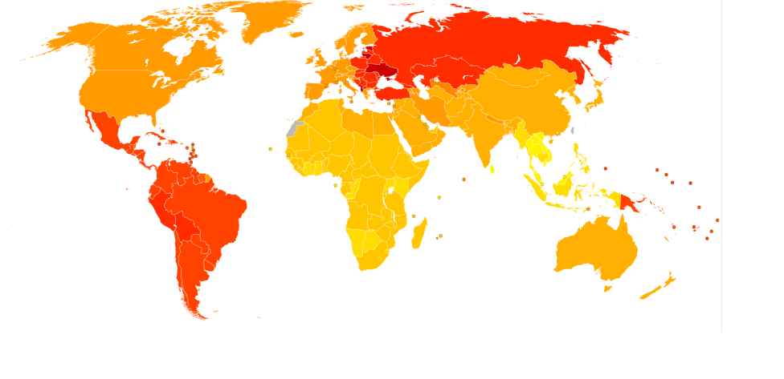
Age-Standardized DALY rates for RA by Country ,WHO 2004
https://commons.wikimedia.org/wiki/File:Rheumatoid_arthritis_world_map_-_DALY_-_WHO2004.svg
Yellow- Red (40-140) per 100,000

Slide 23
Different form of Arthritis

Slide 24
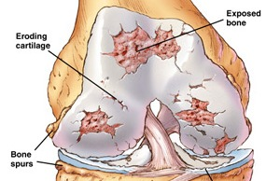
Osteoarthritis (OA)
OA is the most common form of arthritis and is usually caused by the deterioration of a joint.
Weight-bearing joints are affected, with the knee and hip being the most common joints involved.
Until age 50, women and men are affected equally by OA; after age 50, women are affected more than men.
In their lifetime, 21% of overweight and 31% of obese adults are diagnosed with arthritis.
https://en.wikipedia.org/wiki/Arthritis

Slide 25
Osteoarthritis (OA)
Gradual loss of articular
cartilage in in the knee
Joint caused by a
complex interplay of
joint integrity,
Biochemical processes,
genetics,
mechanical forces

Slide 26
Osteoarthritis (OA)
How does it feel?
Stiffness in joint, especially in the morning, which eases in less than 30 minutes.
Stiffness in joint after sitting or lying down for long periods of time (usually after about 45 minutes).
Pain during activity that is relieved by rest.
Cracking, creaking, crunching or other type of joint noise.
Pain on and around the joint.
Joint swelling caused by increase in the size of soft tissue ın and around the joint & Increased bone growth around the joint
Etc.
Pereira D, Ramos E, Branco J (January 2015). "Osteoarthritis". Acta Médica Portuguesa. 28 (1): 99–106. doi:10.20344/amp.5477

Slide 27
Osteoarthritis (OA)
How does it feel?
Arthritis and weather:
Studies show a variety of weather factors can increase pain and joint stiffness, especially;
Temperature (especially lowering)
Barometric pressure (especially falling)
A study from Tufts University in 2007 found that
every 10-degree drop in temperature corresponded with an incremental increase in arthritis pain.
In addition, relatively low barometric pressure can increase pain.

Slide 28
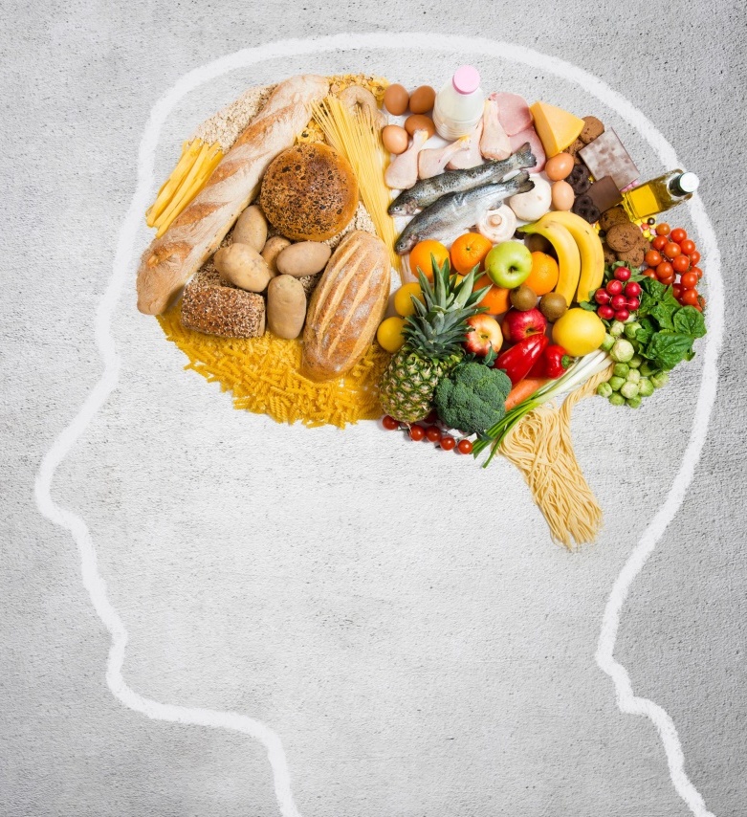
OA Around the World
OA, in general, is on the rise world wide
A group of kinesiologist suggests that OA is less prevalent in
Underdeveloped countries
less furniture, sit on the ground with legs crossed which puts hips and knees through larger, more complete range of motion.
2. Possibly less OA with certain religious activities
Religion and worships that involve kneeling and praying The position puts hips and knees through greater range of motion.
3. Countries that produce olive oil also consume more olive oil.

Slide 29
Rheumatoid Arthritis
Rheumatoid arthritis (RA) is a disorder in which the body's own immune system starts to attack body tissues.
The attack is not only directed at the joint but to many other parts of the body.
RA often affects joints in the fingers, wrists, knees and elbows, is symmetrical (appears on both sides of the body), and can lead to severe deformity in a few years if not treated.

Slide 30
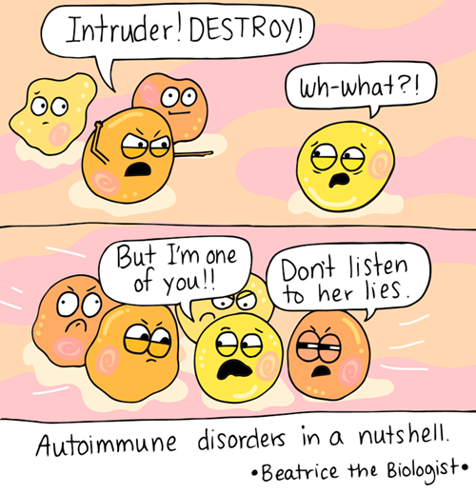
Rheumatoid Arthritis
Although the precise etiology of RA remains uncertain, it results from complex interactions between genes and environment, leading to a breakdown of immune tolerance and to synovial inflammation in a characteristic symmetric pattern
Different mechanisms promote and regulate inflammation and matrix destruction, including damage to bone and cartilage

Slide 31
Rheumatoid Arthritis
Although the precise etiology of RA remains uncertain, it results from complex interactions between genes and environment, leading to a breakdown of immune tolerance and to synovial inflammation in a characteristic symmetric pattern
Different mechanisms promote and regulate inflammation and matrix destruction, including damage to bone and cartilage

Slide 32
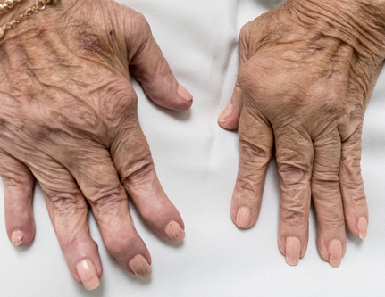
Rheumatoid Arthritis
One of the main triggers of bone erosion in the joints in rheumatoid arthritis is inflammation of the synovium, caused in part by the production of pro inflammatory cytokines and receptor activator of nuclear factor kappa B ligand (RANKL).
Bone erosion is a central feature of rheumatoid arthritis.
Bone continuously undergoes remodelling by actions of bone resorbing osteoclasts and bone forming osteoblasts.
    Inflammation results – pannus (granulation tissue at the joint margins) – articular cartilage destruction

Slide 33
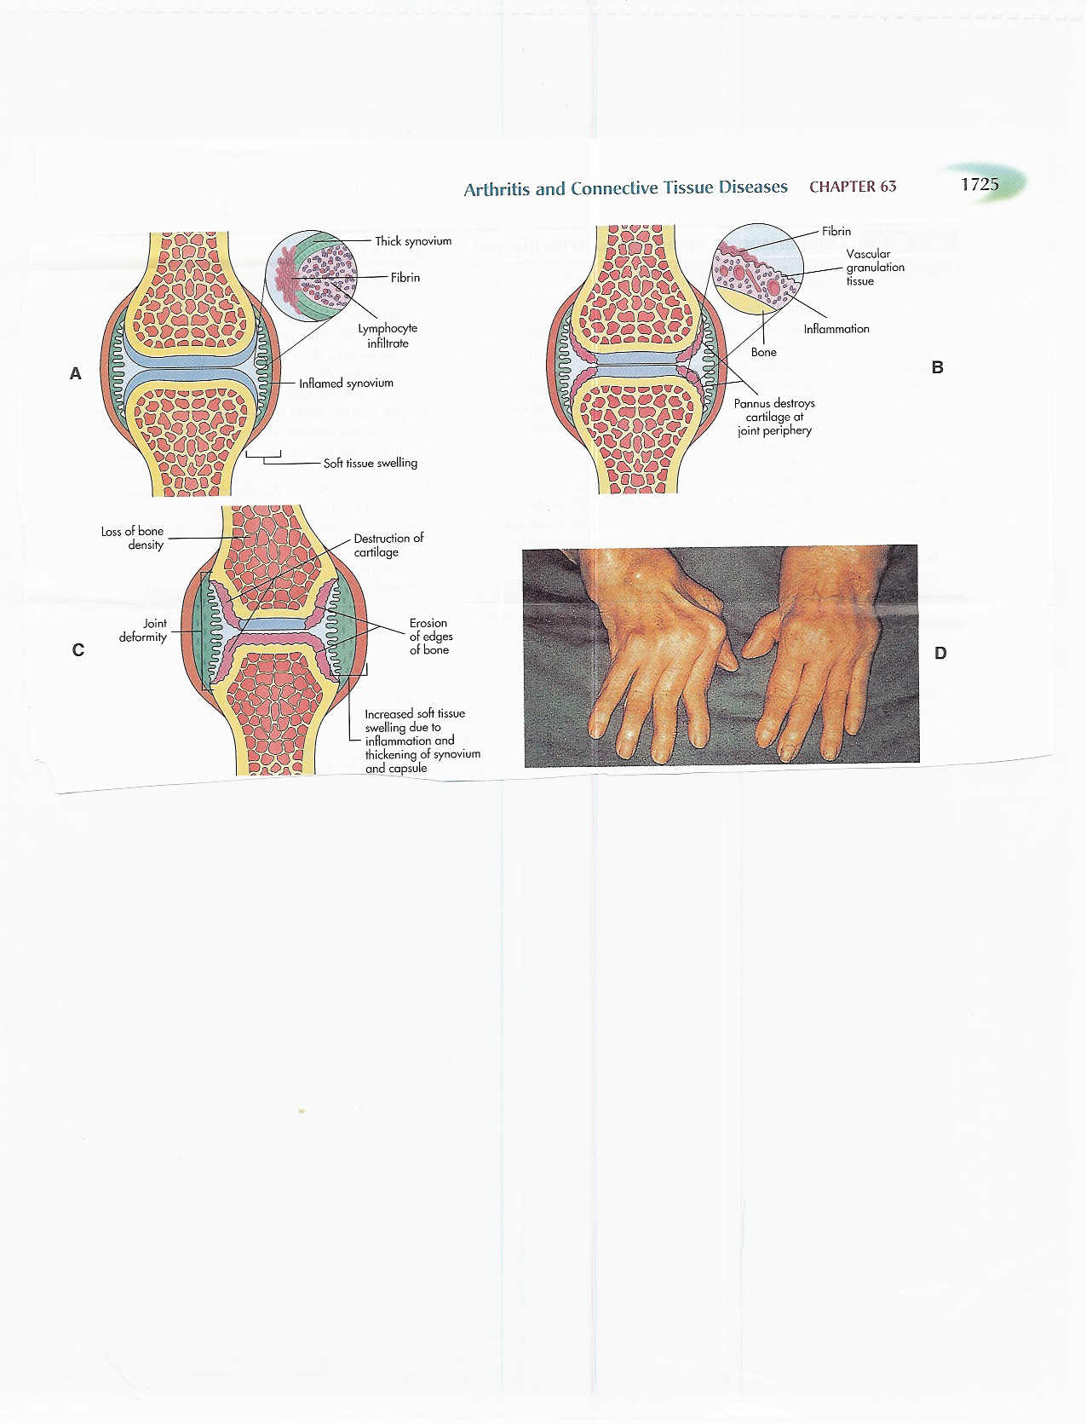

Slide 34
Rheumatoid Arthritis
The initial triggering event is not clear:
T cells and B cells activated (in response to mutated citrullinated vimentin (MCV), structural protein in human). Antibodies to MCV complex with MCV to precipitate in joint
Production of inflammatory cytokines (IL-6,TNF) Macrophages, lymphocytes, and plasma cells
Metalloprotinases (MMP) from Macrophages to damage synovial tissue Rheumatoid factor from plasma cells

Slide 35
Rheumatoid Arthritis
RA occurs mostly in people aged 20 and above. In children, the disorder can present with a skin rash, fever, pain, disability, and limitations in daily activities
The risk factors with the strongest association for developing rheumatoid arthritis are family history of rheumatoid arthritis, Gender, age, obesity, previous joint damage from an injury, and exposure to tobacco smoke

Slide 36
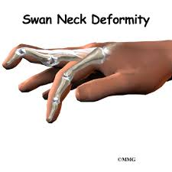
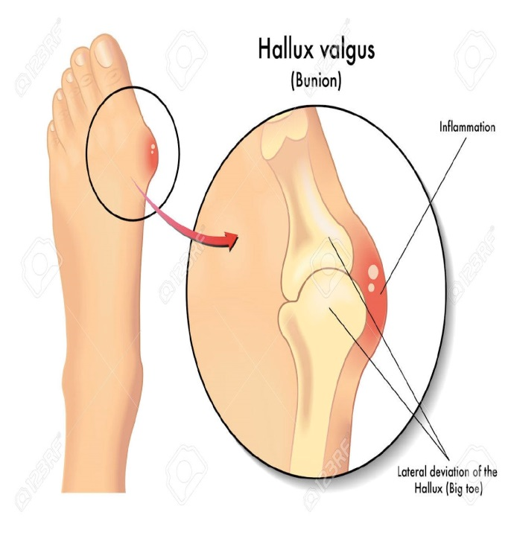
Rheumatoid Arthritis (RA)
How does it feel?
General
Fever & gradual onset of fatigue, anorexia, weight loss, generalized stiffness
Joints
  Stiffness becomes localized associated with pain, edema, limited motion,
  “Morning Stiffness” – 60+ mins to several hours depending on disease progression
  Swollen, redness, warmth, and tenderness ( both sides of the body).
  Loss of joint function
  Joint deformity- swan neck, hallux valgus etc
Pereira D, Ramos E, Branco J (January 2015). "Osteoarthritis". Acta Médica Portuguesa. 28 (1): 99–106. doi:10.20344/amp.5477

Slide 37
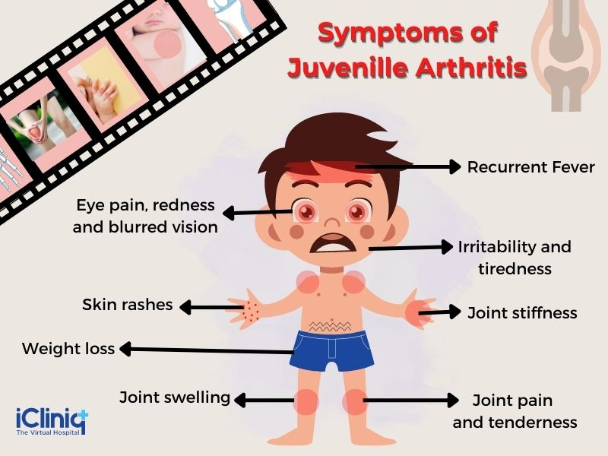
Definition and Pathophysiology of JRA
Most common of the Juvenile Arthritis diseases
Autoimmune disease (Neutrophils are main effector cell)
Symptoms include
  Fatigue
  Decrease physical activity
  Sleep problems
  Swelling at joints
  Inflammation of a finger or toe
  Pits or ridges in fingernails
http://www.arthritis.org/about-arthritis/types/juvenile-idiopathic-arthritis-jia/symptoms.php

Slide 38
Prevalence, Incidence, Attributes
Prevalence
  100,000 children in the U.S have JIA
Incidence
  13.9 per 100,000 children annually
Attributes
  Sex
    One study found that it was more prevalent in girls than boys by a 2 to 1 margin
  Race
    Less common in African-American and Asian populations compared to Caucasian populations
http://www.uptodate.com/contents/juvenile-idiopathic-arthritis-epidemiology-and-immunopathogenesis
http://ped-rheum.biomedcentral.com/articles/10.1186/s12969-015-0030-z

Slide 39
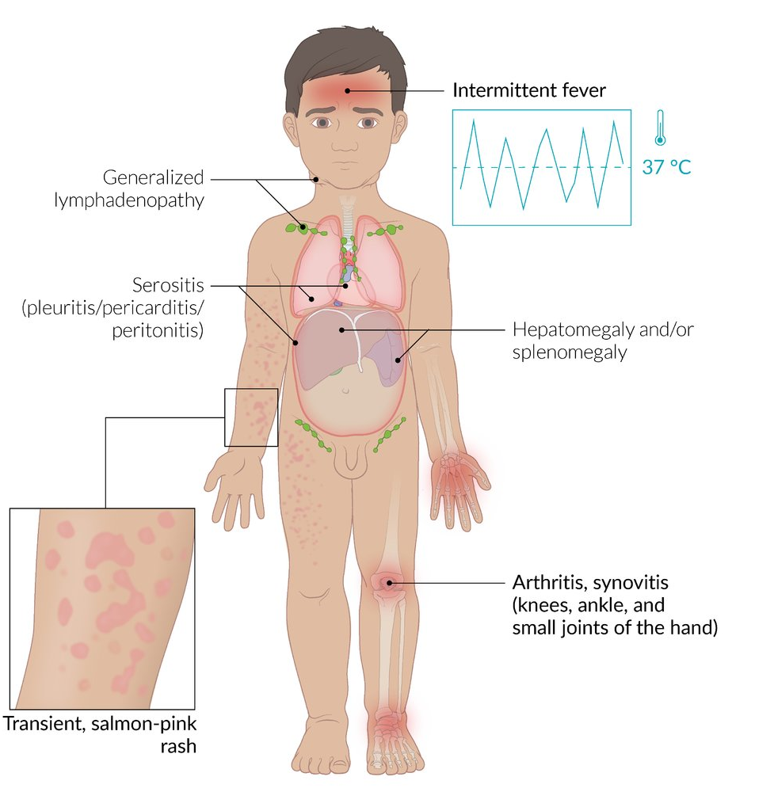
Types of JRA
Systemic onset JRA.
This type affects one or more joints.
It may also cause inflammation of internal organs, including the heart, liver, spleen, and lymph nodes.
It is the least common type.
It affects 1 in 10 to about 1 in 7 children with JIA.

Slide 40
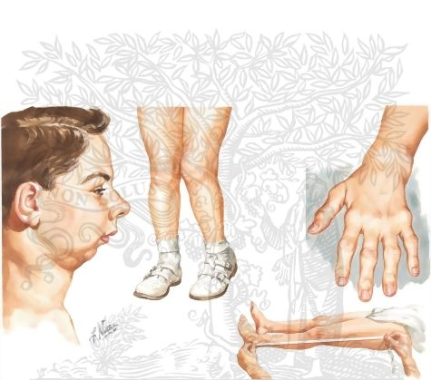
Types of Rheumatoid Arthritis (RA)
Oligoarticular JRA.
This type affects 1 to 4 joints in the first 6 months of disease.
If no more joints are affected after 6 months, this type is called persistent.
If more joints are affected after 6 months, it is called extended.
Polyarticular JRA.
This type affects 5 or more joints in the first 6 months of disease
.

Slide 41
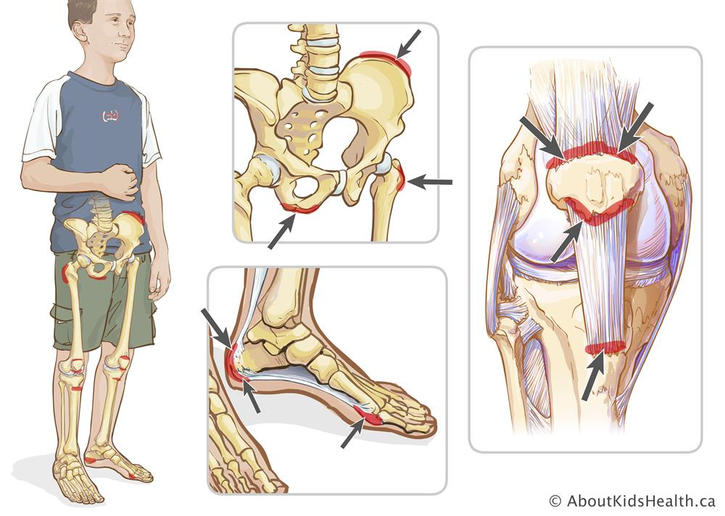
Types of Rheumatoid Arthritis (RA)
Enthesitis-related JRA. With this type, a child has arthritis as well as enthesitis. This is a swelling of the tissue where bone meets a tendon or ligament. It often affects the hips, knees, and feet.

Slide 42
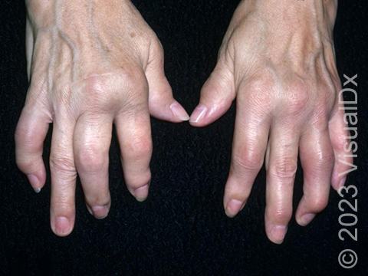
Types of JRA
Psoriatic arthritis.
arthritis and a red, scaly skin disease called psoriasis. With this type, a child may have both
Most commonly the psoriatic arthritis is asymmetric in pattern (unlike other rheumatoid arthritis, which is symmetrical).
When psoriatic arthritis affects the joints of the spine and sacroiliac joints it is called spondylitis
Absence of rheumatoid factor (RF) in the blood helps distinguish psoriatic arthritis from rheumatoid arthritis.

Slide 43
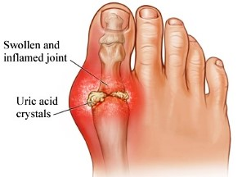
Gout
Gout is caused by
deposition of uric acid crystals in the artıcular, periarticular and subcutaneous tissue, causing inflammation.
formation of rhomboid crystals of calcium pyrophosphate known as pseudogout.
Clinically it is characterized by recurring attacks of acute arthritis by interval of freedom from pain
In late stages by deforming arthritis, nephritis, urinary calculi

Slide 44
Gout
Prevalence
  3.9% of U.S. population (8.3 million people) have gout (NHANES 2007-2008)
  Grew by 1.2 percentage points over 2 decades
Mortality
  Rare, but associated with increased risk for CVD
http://www.cdc.gov/arthritis/basics/gout.html

Slide 45
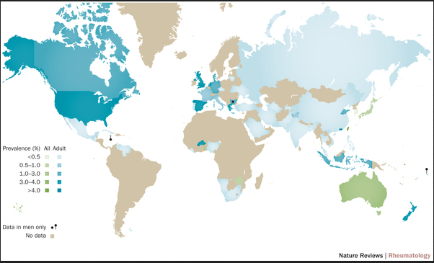
Prevalence of Gout by Country
http://www.nature.com/nrrheum/journal/v11/n11/images_article/nrrheum.2015.91-f1.jpg

Slide 46
Gout
Predisposing factors:
Alcohol abuse
High consumption of Red meat & Beans
Obesity
Diabetes
Hypertension
Hyperlipidaemia
Chronic inflammatory diseases
Long term use of diuretics or aspirin
Hyper parathyroidism
Myeloprolifrative disorders
Chronic Disease Epidemiology and Control (2010)
http://www.commed.vcu.edu/Chronic_Disease/arthritis/CMEGoout.pdf
http://www.cdc.gov/arthritis/basics/gout.html

Slide 47
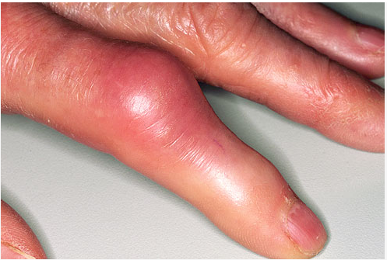
Gout
Primary gout
Common type (95%)
Idiopathic
Hereditary error of purine metabolism
• Due to under excretion or overproduction of monosodium urate (MSU).
Secondary gout 5%
• Prolonged hyperuricaemia
• prolonged Administration of diuretics
• Renal failure .

Slide 48
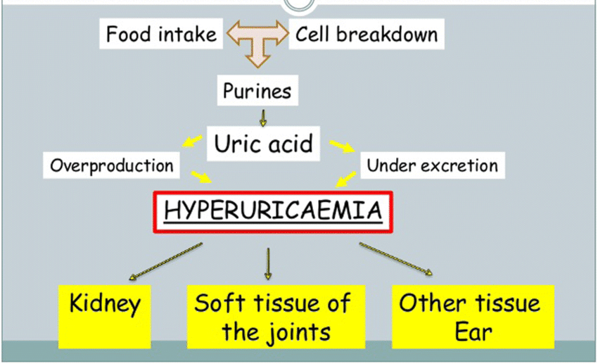
Pathogenesis of Gout

Slide 49
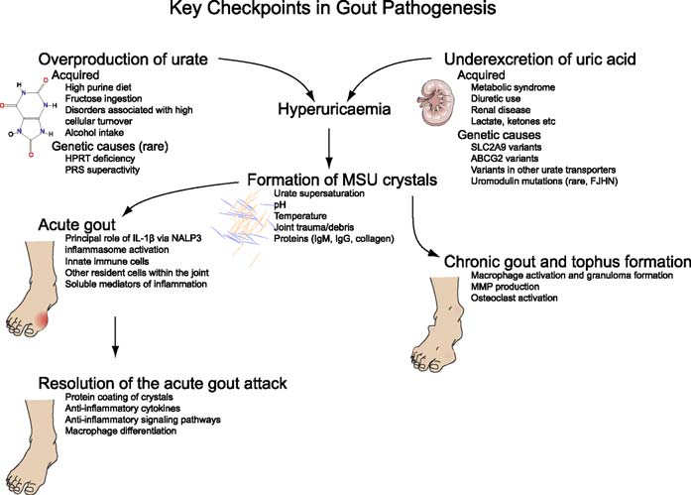
Pathogenesis of Gout
Sodium urate is deposited as crystals on the surface of articular cartilage.
Then articular cartilage is eroded
The subchondral bone is replaced by crystalline deposit, (tophii)
A pannus of granulation tissue grows over the articular surface, invades and replaces the cartilage
Then granulation tissue bridges the joint to the opposite articular surface and producing fibrous ankylosis

Slide 50
Axial spondyloathritis

Slide 51
Definition of Axial spondyloathritis
Axial spondyloathritis is used to describe patients who have both non-radiographic and radiographic axial spondyloathritis.
Non-radiographic axial spondyloathritis does not show on x-ray, but there are changes on MRI.
Radiographic axial spondyloathritis is also known as ankylosing spondylitis (AS).

Slide 52
So What about Axial spondyloathritis
AS Affects 0.1 to 1.4% of the population.
There is a male to female ratio of 2:1 for radiographic axial spondyloathritis and of 1:1 for non-radiographic axial spondyloathritis.
The onset of symptoms generally occurs between 20-40 years of age.
AS is more prevalent within Europe (mean 23.8 per 10,000) and Asia (mean 16.7 per 10,000) than within Latin America (mean 10.2 per 10,000

Slide 53
Pathogenesis
Not well understood
More than 90% heritability has been estimated,
the highest genetic association being with HLA-B27.
The pathogenic role of HLA-B27 is still not clear although various hypotheses are available.
  Arthritogenic peptide hypothesis
  Heavy chain homodimer hypothesis
  HLAB27 misfolding hypothesis

Slide 54
Pathogenesis
Tumour necrosis factor (TNF)-α and interleukin-17 appear to have a relevant role in pathogenesis.
HLA-B27 by far most common

Slide 55
Clinical Manifestations of SpA
Musculoskeletal features
  Inflammatory back pain
  Peripheral arthritis
  Enthesitis (enthesopathy)
  Dactylitis

Slide 56
Inflammatory Back Pain
Young age at onset, typically seen in those under 40 years old
Gradual onset of pain
Symptoms of back pain improve with exercise
Response to NSAIDs
Pain does not improve with rest-pain at night, often waking a person in the second half of the night
Morning stiffness that lasts for more than 30 minutes
Pain lasting for more than 3 months
Alternating buttock pain

Slide 57
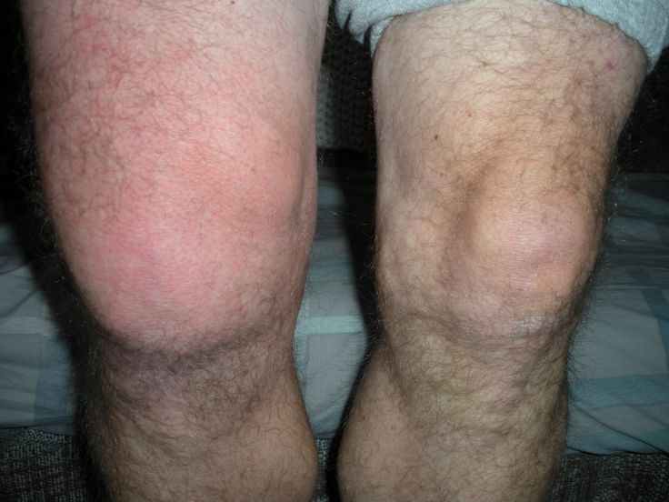
Peripheral Arthritis
Acute Onset
Predominately effects the lower extremities
Associated with swelling
Usually asymmetric
Effects 1 to 3 joints
  Oligoarthritis
Notes:
Most commonly effects the knees and ankles

Slide 58
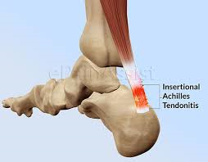
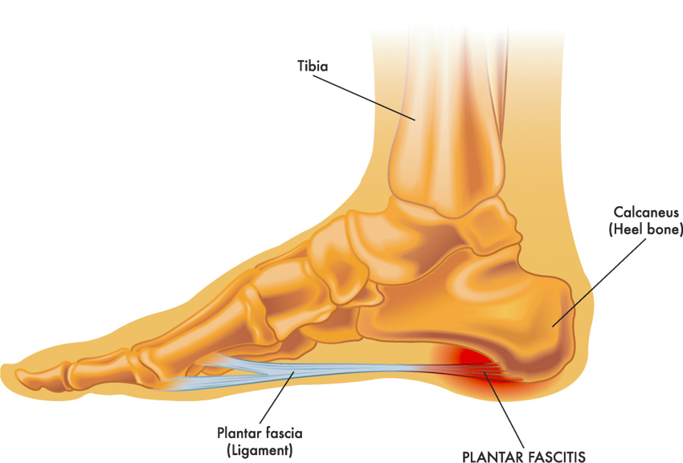
Enthesitis (enthesopathy)
Inflammation
  Ligament to bone
  Tendon to bone
  Joint capsule
  Fascia to bone
Most commonly manifested as:
  Achilles tendinopathy
  Plantar fasciitis

Slide 59
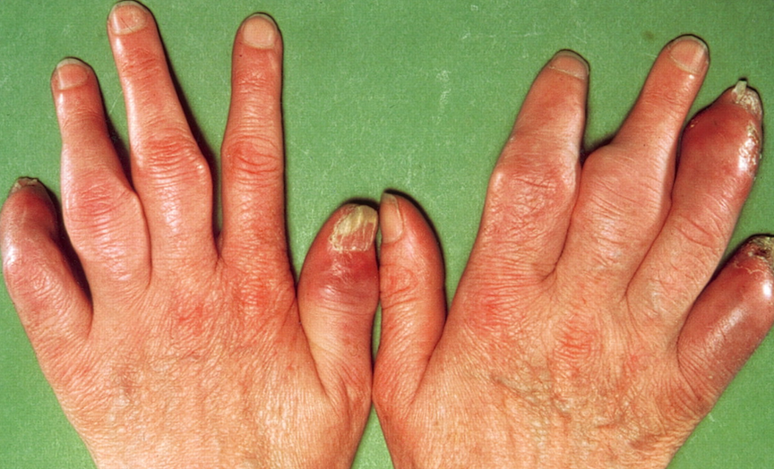
Dactylitis
Notes:
“Sausage Digits”
Swelling of the entire digit- less common manifestation

Slide 60
Diagnosis

Slide 61
Diagnosis
Clinical Diagnosis
Radiological diagnosis
Laboratory Diagnosis

Slide 62
Diagnosis of Axial Spondyloathritis

Slide 63
Laboratory Findings
HLA-B27
  Positive in 70-90% of patients with AS
  Positive in 50% to 70% of patients with other forms of SpA
  Note: HLA-B27 positivity is NOT diagnostic in itself
  Note even required for the diagnosis
        Seen in 6% of the general population
Acute Phase Reactants (ESR and CRP)
Elevated in 35% to 50% of patients
Elevated CRP is an indication of:
      Radiographic disease progression
      Positive response to TNF alpha inhibitors

Slide 64
Imaging Findings
Plain Radiographs
  Axial
    Only specific finding is evidence of sacroiliitis (images to follow)
      May take years to develop
    Bridging axial syndesmophytes seen on <5% of patients in the absence of sacroiliitis
      50% of patients develop syndesmophytes during course of disease
  Peripheral
    Erosive joint changes
    Evidence of Enthesitis

Slide 65
Sacroiliitis on Plain Radiographs
Graded 0 to 4
  Grade 0: Normal
  Grade 1: Suspicious changes
  Grade 2: Minimal abnormality – Small localized areas with erosions or sclerosis, without alteration in the joint width
  Grade 3: Unequivocal abnormality – Moderate or advanced sacroiliitis with erosions, evidence of sclerosis, widening, narrowing, or partial ankylosis
  Grade 4: Severe abnormality – Total ankylosis
Considered “Positive for Suggestion of SpA” if:
  Grade 2 or higher bilateral
  Grade 3 or higher unilateral
Notes:
This is the modified New York Criteria

Slide 66
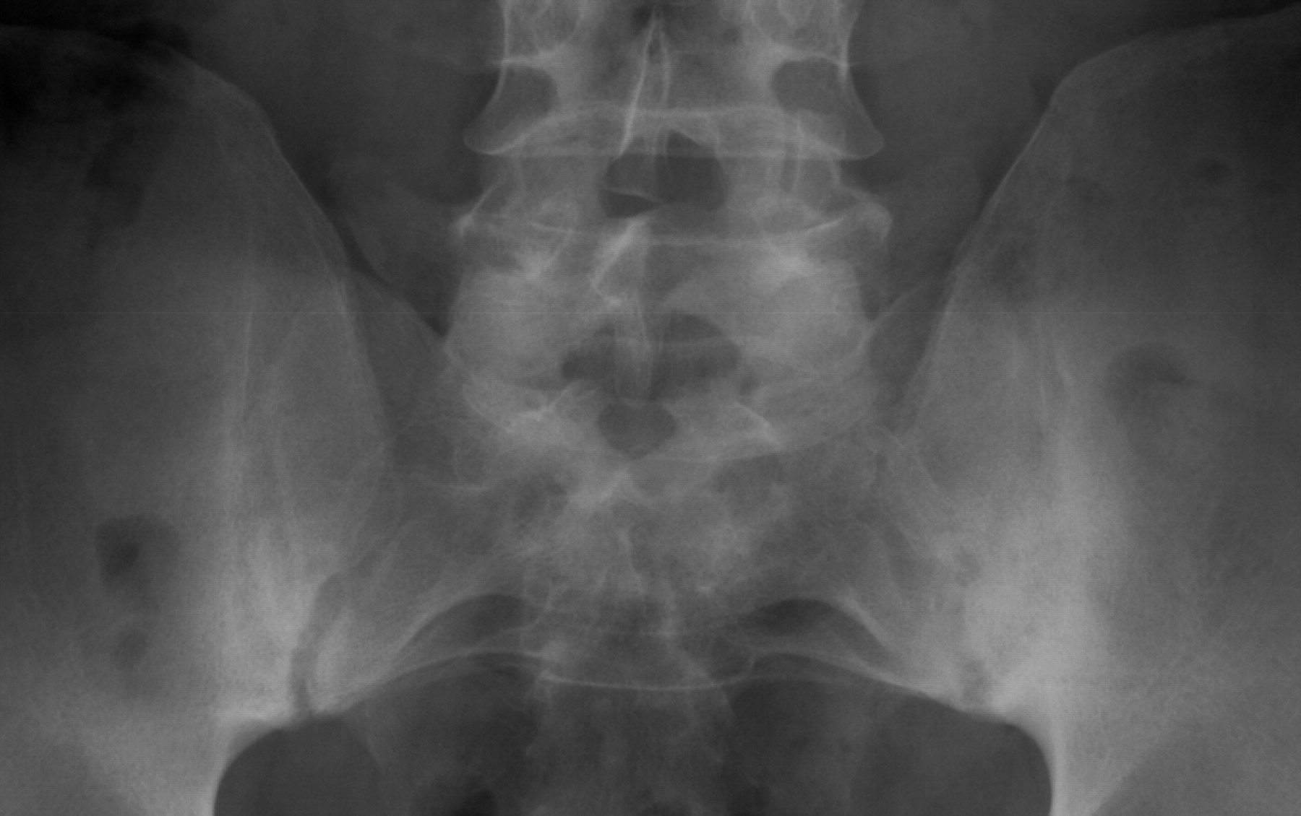
Sacroiliitis on Plain Radiographs (Grade 2)
Both sacroiliac (SI) joints show ill-defined margins, sclerosis, and especially at the left SI joint an irregular joint space (grade 2 bilaterally).

Slide 67
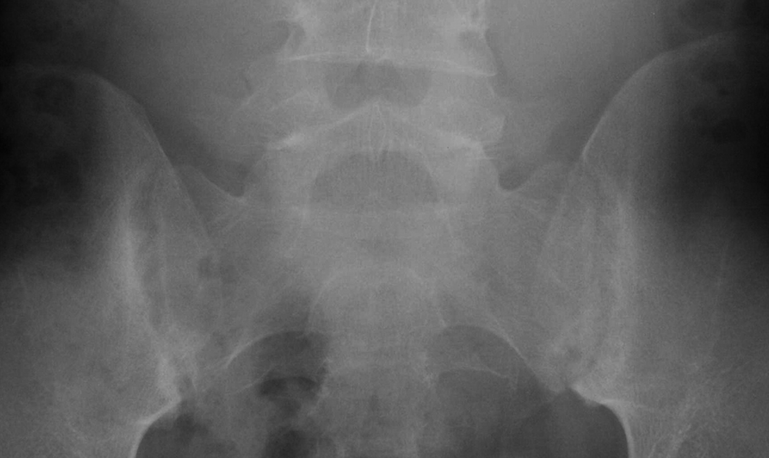
Sacroiliitis on Plain Radiographs (Grade 3)
Sclerosis at the iliac side, widespread erosions, pseudo widening of the joint space, blurring of the joint margins in both sacroiliac (SI) joints (bilateral grade 3).
Notes:
Remember grade 3 or higher, even if unilateral is suggestive of SpA

Slide 68
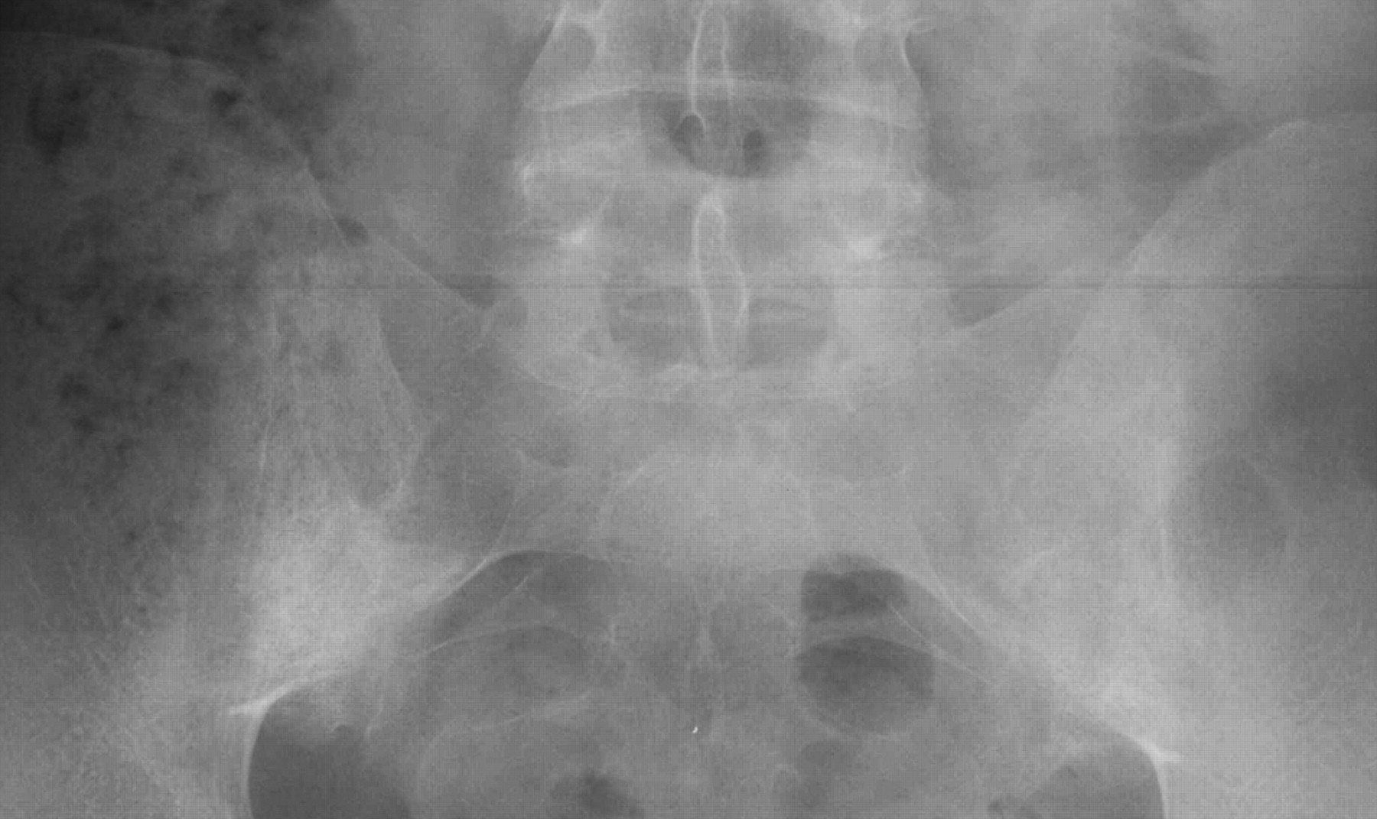
Sacroiliitis on Plain Radiographs (Grade 4)
Both sacroiliac (SI) joints show complete ankylosis (grade 4).

Slide 69
Syndesmophytes on Plain Radiographs

Slide 70
Diagnostic Criteria- Axial SpA
Notes:
Speaking: So the first tier, they have to have had the pain for at least 3 months and onset has to be before the age of 45

Slide 71
Diagnostic Criteria- Axial SpA

Slide 72
Diagnosis of Osteoarthritis

Slide 73
Clinical diagnosis is made with reasonable certainty based on;
Subjective assessment /History
Physical /Clinical examination
Clinical Diagnosis of
Osteoarthritis

Slide 74
Clinical Diagnosis
Knee pain plus at least 3 of the following 6 characteristics:
50 yo and above
Morning stiffness less than <30minutes
Crepitus
Bony tenderness
Bony enlargement
No palpable warmth
In 1990, the American College of Rheumatology (ACR), using data from a multi-center study, developed a set of criteria for the diagnosis of osteoarthritis
These criteria were found to be 92% sensitive and 98% specific for hand osteoarthritis
Altman R, Alarcón G, Appelrouth D, Bloch D, Borenstein D, Brandt K, et al. (November 1990). "The American College of Rheumatology criteria for the classification and reporting of osteoarthritis of the hand". Arthritis and Rheumatism. 33 (11): 1601–1610. doi:10.1002/art.1780331101

Slide 75
Laboratory Diagnosis
There is no blood test to confirm diagnosis of osteoarthritis.
Blood tests are performed to exclude
diseases that can cause secondary osteoarthritis,
other arthritis conditions that can mimic osteoarthritis
FBC – NORMAL
ESR – NORMAL
CRP - NORMAL
SYNOVIAL FLUID ANALYSIS
Viscous
CCPD and calcium phosphate

Slide 76
Radiological Diagnosis
Bone Scan
CT
MRI
General x-ray

Slide 77
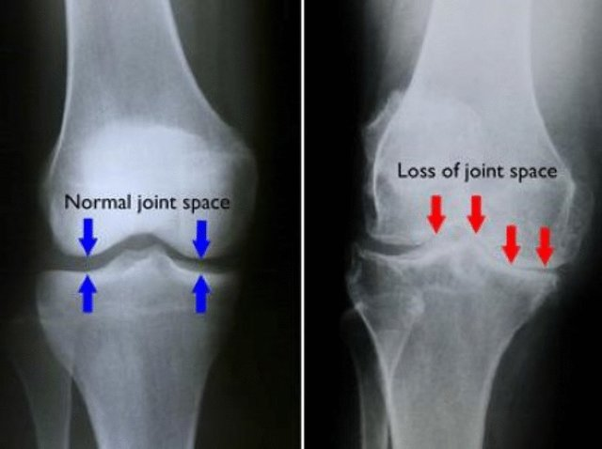
Radiological diagnosis
Features
X-rays may confirm the diagnosis.
The typical changes seen on X-ray include
JSN
Osteophytosis
Subchondral sclerosis
Subchondral cysts

Slide 78
Does the Radiologic changes correlate with the degree of disease?

Slide 79
Classification of OA diagnosis
A number of classification systems are used for gradation of osteoarthritis:
WOMAC scale, taking into account pain, stiffness and functional limitation
Kellgren-Lawrence grading scale for osteoarthritis of the knee. It uses only projectional radiography features.
3. Tönnis classification for osteoarthritis also uses only projectional radiography features.
^{ETC}

Slide 80
Diagnosis of Rheumatoid Arthritis

Slide 81
Clinical Diagnosis
Insidious – fatigue, anorexia, weight loss, generalized stiffness
Joints
  Stiffness becomes localized—pain, edema, limited motion, inflammation, joints warm to touch, fingers—spindle shaped
  “Morning Stiffness” – 60+ mins to several hours depending on disease progression

Slide 82
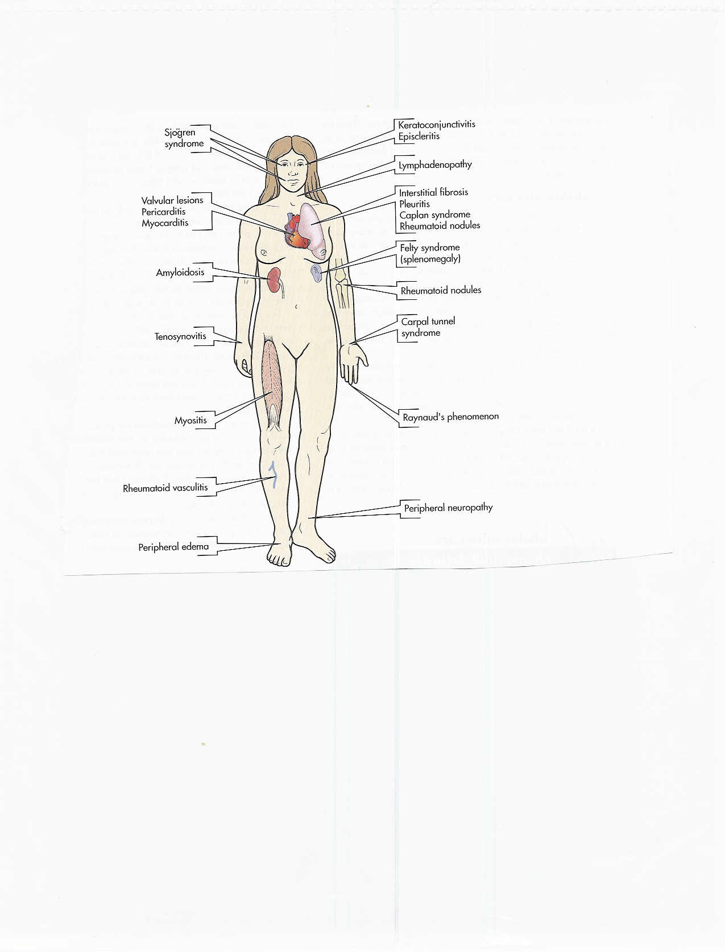
Complications

Slide 83
Laboratory Diagnosis
  Rheumatoid Factor – 80% of patients
  ESR
  C-Reactive Protein
  WBC up to 25,000/ul
Synovial biopsy – inflammation
Bone Scan

Slide 84
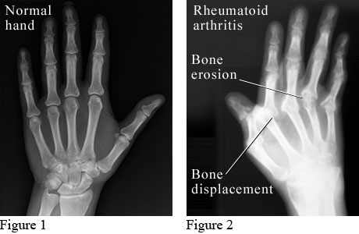
Radiological Diagnosis
The radiographic hallmarks of Rheumatoid arthritis are
swelling of the soft tissue,
osteoporosis,
narrowing of the joint spaces
marginal erosions.

Slide 85
Radiological Diagnosis
The unique combination of osteoporosis, marginal erosions and relatively minimal reactive bone formation help distinguish rheumatoid arthritis from other inflammatory arthritis.

Slide 86
DIAGNOSIS; The American College of Rheumatology and European League Against Rheumatism 2010 Guideline (ACR/EULAR) 2010 guidelines
There are categories A to D
  Category A: Joint Involvement
  Category B: Serology
  Category C: Acute Phase Reactants
  Category D: Duration of Symptoms
Patients must have a score of equal or greater than 6 out of 10

Slide 87
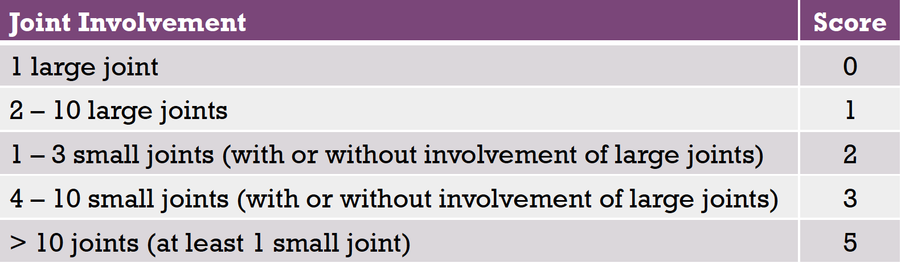
DIAGNOSIS; The American College of Rheumatology and European League Against Rheumatism 2010 Guideline (ACR/EULAR) 2010 guidelines-
Cart A; Joint Involvement
Small Joint: wrists, metacarpophalangeal joints, proximal interphalangeal joints, 2nd – 5th metatarsophalangeal joints, and thumb joints
Large joint: shoulders, elbows, hips, knees, and ankles

Slide 88
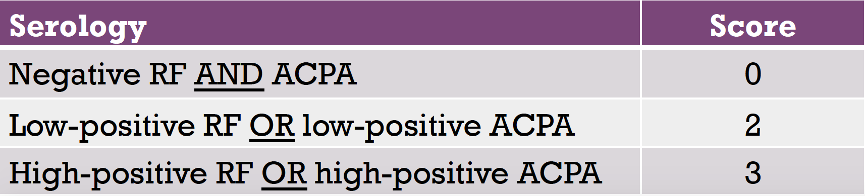
DIAGNOSIS; The American College of Rheumatology and European League Against Rheumatism 2010 Guideline (ACR/EULAR) 2010 guidelines-
Cart B; Serology
RF – rheumatoid factor
ACPA – anti-citrullinated protein antibody
Low-positive: defined as higher than the upper limit of normal (ULN) but not equal or less than three times of the ULN
High-positive: defined as greater than three times of ULN

Slide 89
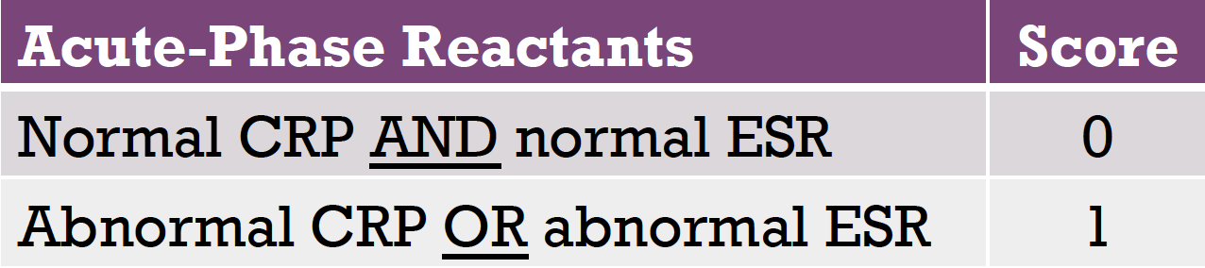
DIAGNOSIS; The American College of Rheumatology and European League Against Rheumatism 2010 Guideline (ACR/EULAR) 2010 guidelines-
Cart C; Acute phase Reactants
CRP – C-reactive protein
ESR – Erythrocyte sedimentation rate

Slide 90
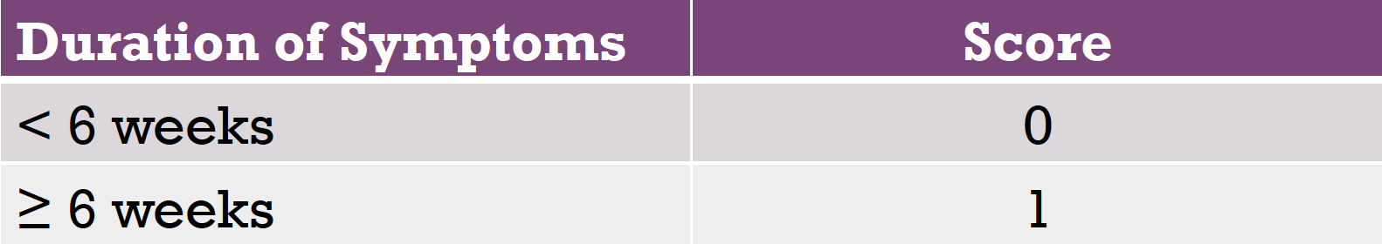
DIAGNOSIS; The American College of Rheumatology and European League Against Rheumatism 2010 Guideline (ACR/EULAR) 2010 guidelines-
Cart D; Patient report of duration of symptoms
Patient self-report on duration of signs/symptoms

Slide 91
INTERVENTION

Slide 92
Primary Prevention
  Avoid joint trauma
  Weight reduction & Prevention of Obesity
  Regular Physical activity
  Modifying occupational joint stress
  Dietary Changes
  Moderation/Elimination of alcohol
  Smoking cessation
  Adequate intake of Vitamin D and Calcium during childhood
  Hormone Therapy (Post-Menopause)
Chronic Disease Epidemiology and Control (2010)

Slide 93
Secondary Intervention
  X-rays and other radiographs in older patients
  Treating those with asymptomatic conditions
Chronic Disease Epidemiology and Control (2010)

Slide 94
Tertiary Intervention- Individual
Pharmalogical
  OA
  Acetaminophen, Glucosamine, NSAIDS & Opioids analgesics
  Intra-artıcular injections
  Glucocorticoids, prednisolone
  RA
  DMARD (injectable gold, azathioprine etc.)
  Biologic response Modifiers
  Protien A immunoadsorption therapy
Non-pharmalogical
  Physiotherapy
  Support Groups
  Surgery
Chronic Disease Epidemiology and Control (2010)

Slide 95
Principle of Physiotherapy
Assessment and formulation of physiotherapy diagnosis
Management of impairments related to pain on movement, decreased ROM, Muscle weakness, limited endurance and improper use of ambulatory device
Rehabilitation to reduce
Reduce Activity limitation & Participation restrictıon
Ineffective coping strategies related to actual or perceived lifestyle or role changes

Slide 96
Physiotherapy intervention recommendations based on meta-analysis and systematic Review and Guidelines from NICE, OARSI and EULAR
British Medical Bulletin, 2017, 1–11 doi: 10.1093/bmb/ldx012

Slide 97
Physiotherapy intervention recommendations based on meta-analysis and systematic Review and Guidelines from NICE, OARSI and EULAR (2017)
Areas of agreement:
There is strongest evidence to support the use of exercise to improve pain, function and quality of life.
2. Areas of controversy:
There is limited evidence to support the use of some
commonly utilized physiotherapy interventions such as TENS, Ultrasound

Slide 98
NICE RECOMMENDATIONS
Exercise
Advise people with osteoarthritis to exercise as a core treatment, irrespective of age, comorbidity, pain severity or disability.
Exercise should include: local muscle strengthening and general aerobic fitness

Slide 99
NICE RECOMMENDATIONS
Education/self-management
1. Offer accurate verbal and written information to all people with osteoarthritis to
enhance understanding of the condition and its management
to counter misconceptions.
2. Ensure that information sharing is an ongoing, integral part of the management plan rather than a single event at time of presentation•
3. Agree individualized self-management strategies with the person with osteoarthritis
Suggested implementation of education in primary care
by means of group sessions and telephone based
Sessions (OARSI).

Slide 100
NICE RECOMMENDATIONS
Education/self-management
1. Offer accurate verbal and written information to all people with osteoarthritis to
enhance understanding of the condition and its management
to counter misconceptions.
2. Ensure that information sharing is an ongoing, integral part of the management plan rather than a single event at time of presentation•
3. Agree individualized self-management strategies with the person with osteoarthritis
Suggested implementation of education in primary care
by means of group sessions and telephone based
Sessions (OARSI).

Slide 101
Weight Reduction?
Loss of at least 10% of body weight can lead to significant improvement in symptoms, pain relief, physical function and health-related quality of life
Bracing and orthotic support for the knee joınt can provide 10% relieve of weight through the joint.
Ankle support- 5%

Slide 102
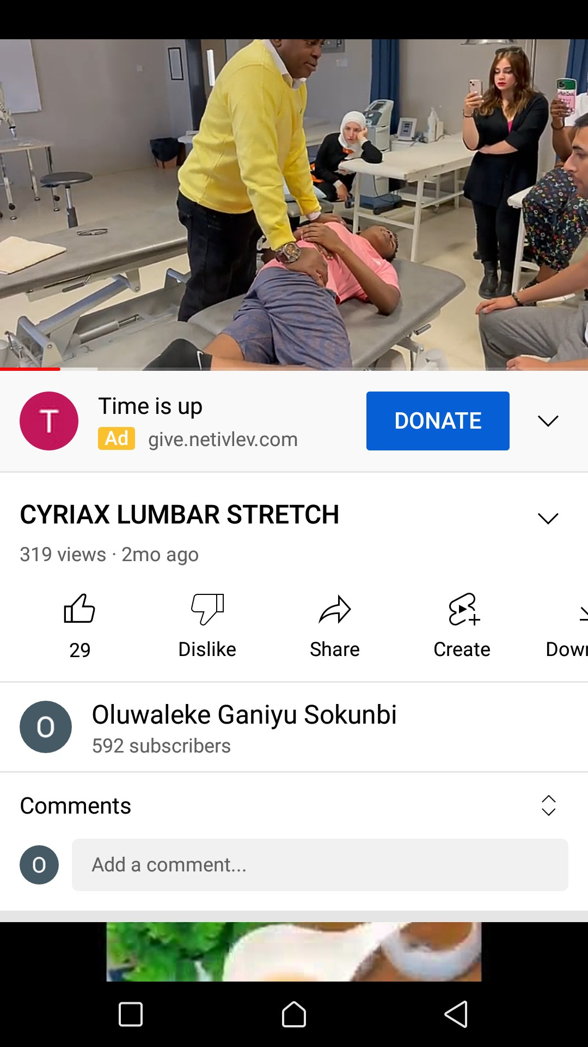
NICE RECOMMENDATIONS
Manual therapy ; Manipulation and stretching should be considered as an adjunct to exercises
• Manual therapy was not included other guıdelines due to insufficient available evidence

Slide 103
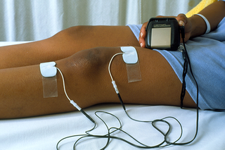
NICE RECOMMENDATIONS
TENS
Healthcare professionals should consider the use of transcutaneous electrical nerve stimulation as an adjunct to core treatments for pain relief

Slide 104
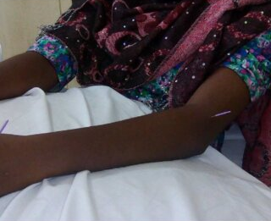
OARSI RECOMMENDATIONS
ACUPUNCTURE
Recommendation: Uncertain
• A recent pooled analysis of 16 RCTs found statistically significant benefit of acupuncture in sham-controlled trials, though this did not reach the investigators’ threshold for clinical
significance

Slide 105
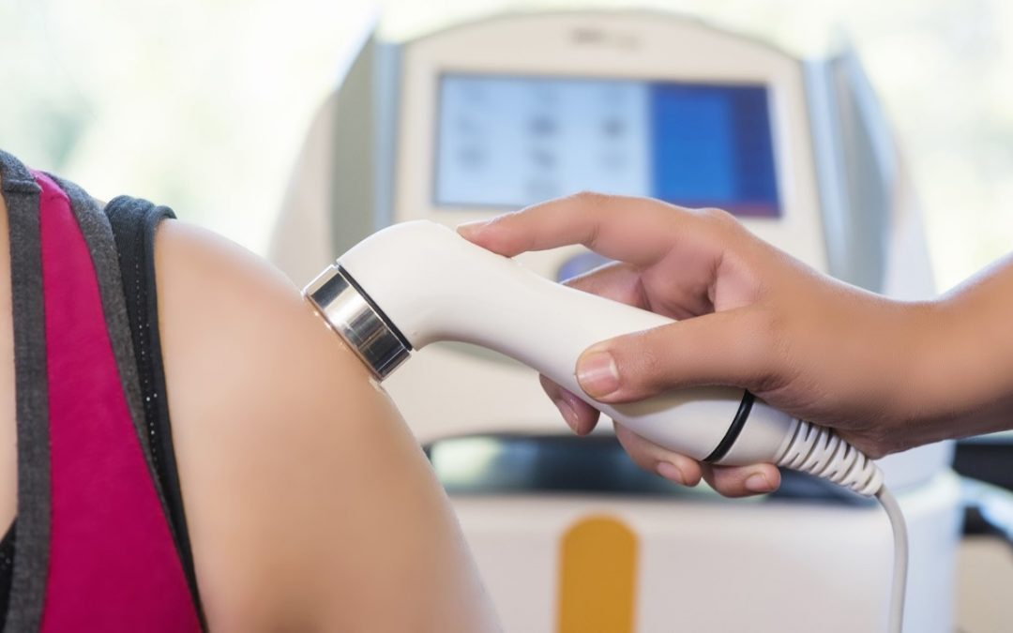
OARSI RECOMMENDATIONS
Therapeutic ultrasound
Recommendation: Uncertain
• SRs suggested a possible beneficial effect of ultrasound for knee OA; however,
the quality of the analyzed evidence was low.
No safety risks were reported to be associated with ultrasound.
A 2012 RCT found no significant differences between the groups for pain or function

Slide 106
BEST PRACTICE RECOMMENDATIONS FOR THE MANAGEMENT OF RA
Ttreatment profile 1:
A short period of education, advice, and exercise/movement instruction
Treatment profile 2:
A short period of guidance and supervision in addition to 1, e.g., due to the complexity or severity of problems or limited self-management skills
Treatment profile 3:
Intensified guidance and supervision in addition to 1, eg, due to the presence of serious comorbidity or complications of the disease or its treatment
Physical therapists should classify patients with RA into 1 of 3 treatment profiles based on the initial
Assessment of self management skills:
PTJ: Physical Therapy & Rehabilitation Journal | Physical Therapy, 2021;101:1–16
https://doi.org/10.1093/ptj/pzab127
Advance access publication date May 17, 2021
Clinical Practice Guidelines

Slide 107
BEST PRACTICE RECOMMENDATIONS FOR
RA PATIENTS EDUCATION
Education
Both family and patient must be educated as to the nature
of the disease. The following topics should be discussed:
Description of joint structure.
What RA is and is not?
Effect rheumatoid arthritis on joints connective tissues and organs in the body.
Emphasis on present management strategies and how the patients and the family members could be part of it
.
Common deformities sequel to RA and how ıt could be prevented with emphasıs on self management
Easy to follow pictorial leaflet for exercise on land and in water, rest. Use of splint and general relaxation should be provided
When possible audiovisuals about the disease and treatment strategies should be used and make available.
Encourage group discussion among the patients

Slide 108
“Don’t stop moving because you get old and suffering with arthritis. You get old and suffer arthritis because you stop moving!”
Thank you

